Slide 1
DATA SCIENCE
PART TIME COURSE
Week 1 - Course Overview & Getting Started

Slide 2
AGENDA
Meet The Instructors
Meet Your Classmates
Instructor Philosophy
Content Philosophy
How To Succeed
Typical Class
Logistics
Course Project
Setting Up

Slide 3
GREG BAKER - INSTRUCTOR
ABOUT ME
Freelance data science consultant, previously at Google and CSIRO. His username is solresol because there are too many Greg Bakers in this world.
Freelance data scientist, previously working in the areas of fraud detection, insurance and web analytics. He provides analytics services for businesses ranging from startups to ASX100 listed companies
http://www.flickr.com/photos/michaelhooper/7876600000/
P∀

Slide 4

AMANDA PARKER - TA
Growth hacker at Atlassian. Previously did Data Science #5 at General Assembly.

Slide 5
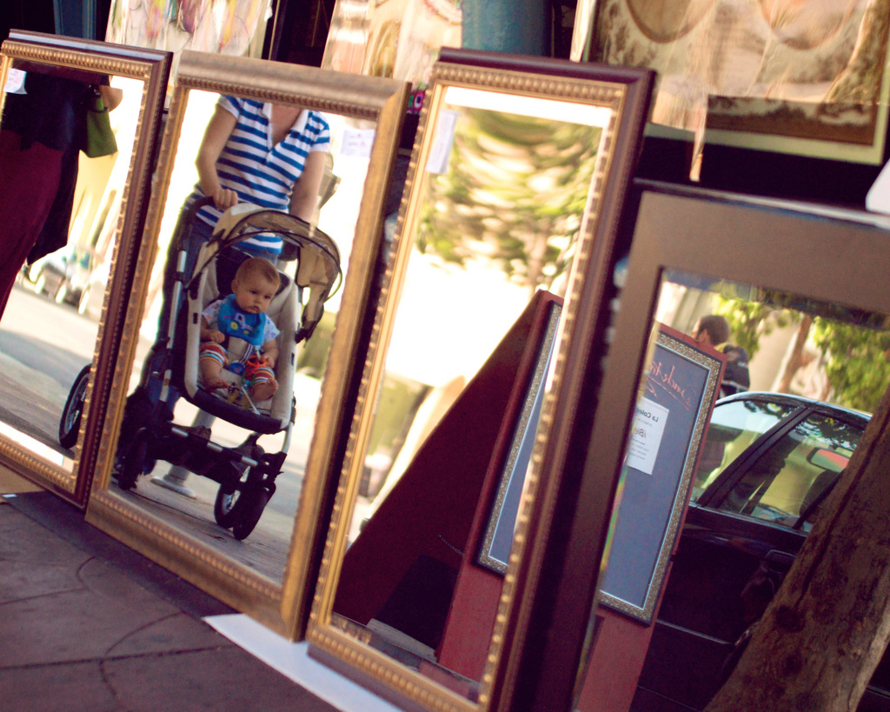
ABOUT YOU ?
ABOUT YOU
ABOUT ME
Who are you?
Why are you interested in Data Science?
Have you done anything with Python (or R)?
What is your exposure to Data Science so far?
Do you have any applications in mind?
http://www.flickr.com/photos/davefayram/3803310706

Slide 6

CONTENT PHILOSOPHY
Application-based Approach
Understand Key Principles
Balance Depth and Breadth
Course Project

Slide 7
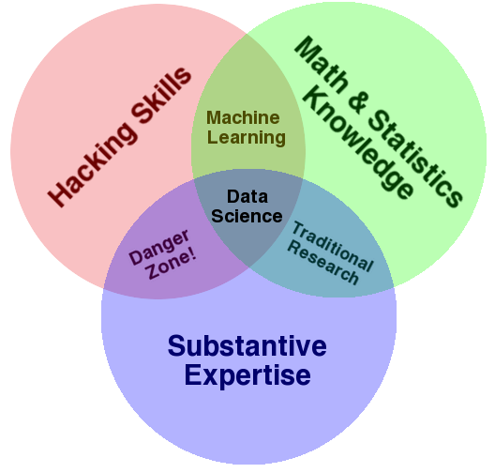
CONTENT PHILOSOPHY
Multidisciplinary Investigations
Models and Methods for Data
Computing with Data
Pedagogy
Tool Evaluation
Theory
Data Science: An Action Plan for Expanding the Technical Areas of the Field of Statistics
William S. Cleveland
Drew Conway’s
Data Science Venn Diagram

Slide 8
TYPICAL CLASS
Guest Speaker (very occasionally)
Random question time, discussion of homework
Overview of lesson objectives
Motivating Problem
Greg talks and displays Powerpoint slides
Code-along exercise: we all code something at the same time
Code Exercises: Amanda and Greg wander around looking over your shoulder as you do some hands-on exercises
Today won’t be a typical class

Slide 9




LOGISTICS
Food
Dress Code
Start and end on time
Missing Class
Slack Instead of Email
Office Hours
Github for course content and homework

Slide 10
Etiquette
It’s not like school or university
Best analogy: work meeting?

Slide 11
COURSE PROJECT
The final project should represent significant original work applying data science techniques to an interesting problem. Final projects are individual attainments, but you should be talking frequently with your instructors and classmates about them.
Address a data-related problem in your professional field or a field you're interested in. Pick a subject that you're passionate about; if you're strongly interested in the subject matter it'll be more fun for you and you'll produce a better project!

Slide 12
Software Setup
Prework
Software Installations
Anaconda Python 2.7
Slack (and account setup - WITH PHOTO!)
DATA SCIENCE - Week 1 Day 1
15

Slide 13
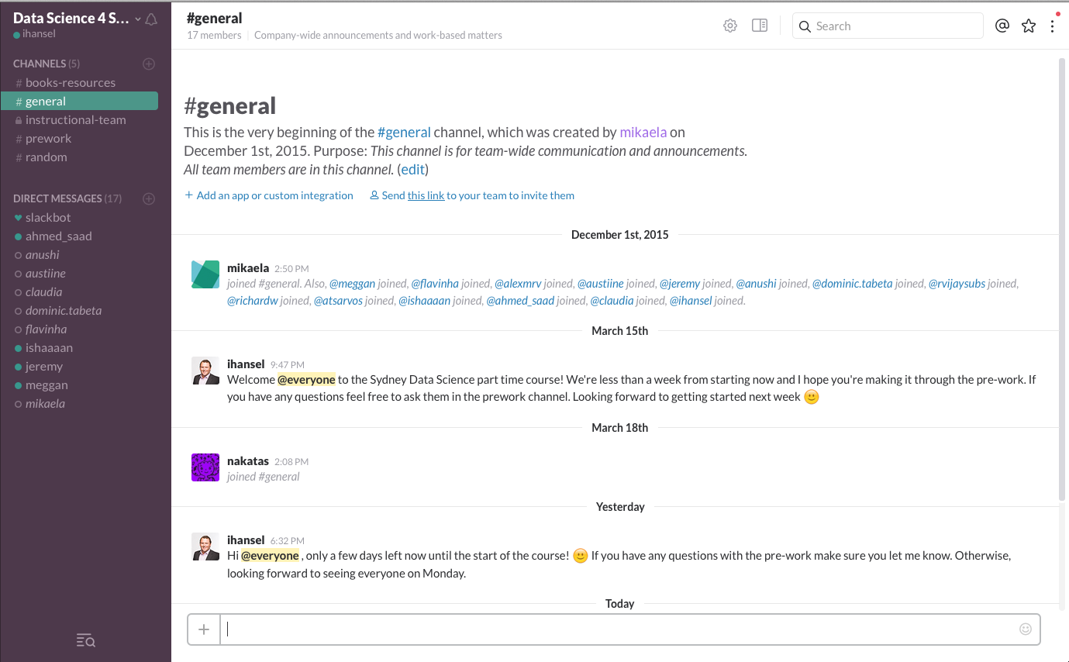

Slide 14
CODE-ALONG
Create a Jupyter notebook by running jupyter notebook
Write a “Hello World” notebook

Slide 15
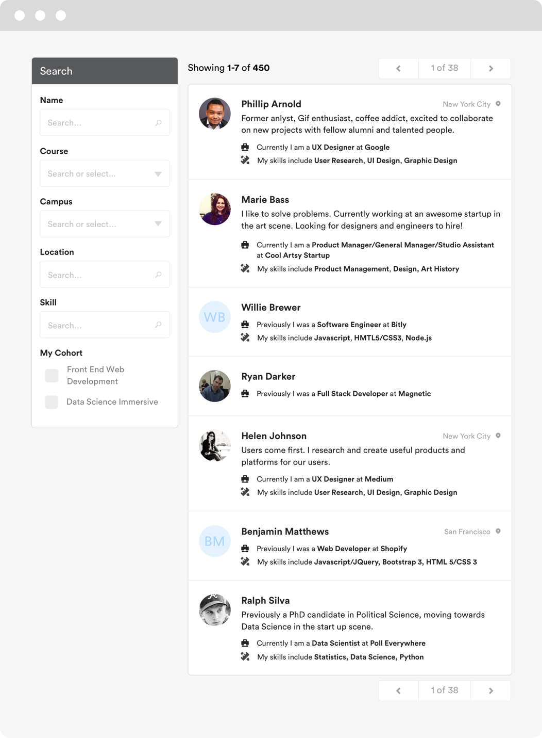

GA Directory
The GA Directory is a place for students, alumni and instructors to connect.
Find your classmates
Reach out to alumni and instructors
Hire talent based on skills and experience
directory.generalassemb.ly

Slide 16
Optional Reading
Codecademy Python course An Introduction to Statistical Learning
Python for Data Analysis
Learn Python the Hard Way
Command Line Crash Course
Khan Academy – Probability
DATA SCIENCE - Week 1 Day 1
17

